Slide 1
Have true urge to realize God :
One can enjoy the spiritual Bliss only when he has at least the same urge to realize The Eternal Reality as one has an intensive urge to don best clothes, shoes or to eat sumptuous food.

Slide 2
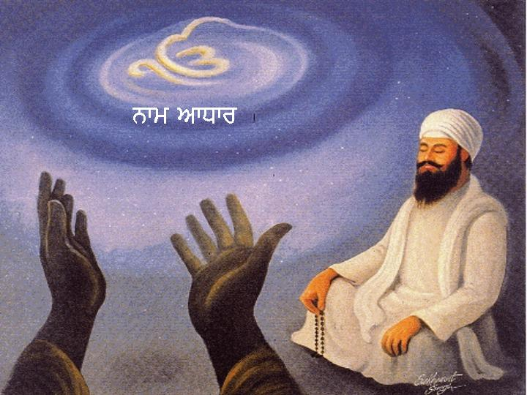
The sinful impressions of the mind can be erased through meditation:
“Janam Janam Kee Es Mun Kau Mal Lagee Kala Hoaa Siaah.”

Slide 3
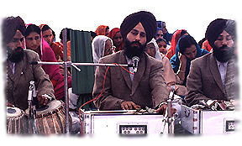
The method of self introspection has been taught by Guru Nanak Dev Ji in these words
“Moot Paleetee Kapari Hoe. De Saboon Laieeyae Oh Dhoe.
Bhrriae Mett Papan Kae Sang. Oh Dhoppae Navae Kae Rung”.

Slide 4

Gurmat way of living means
:
Getting up early in the morning (three hours before Sun rising),
reciting ‘Waheguru’ (gurmantra) after taking bath,
performing ‘Nitnem’ i.e. reciting Jap Ji Sahib, Jaap Sahib, Sudha Swaijae, Chaupaiee and Anand Sahib
and then going to Gurdwara Sahib;

Slide 5
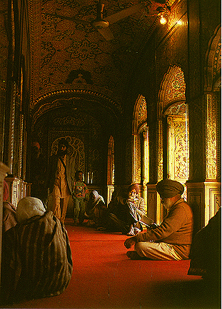
During evening time reciting Rehraas attending the congregation in Gurdwara Sahib; reciting ‘Sohila’ at night;
Meditating on the ‘Divine Name’ while doing routine works.
Earning with honest labour.

Slide 6
Remember four cardinal principles along with meditation and kirtan :
  Ghal Khaiye Kich Hathon De Nanak Rah Pacchane Sae…
  Mithat Neeveen Nanaka Gun Changiaayian Taat…
  Farida Je Too Akel Latiff Kale Likh Na Lekh…
  Dya Janae Jee Kee Kich Pun Daan Karae…

Slide 7

There is no paucity of time for ‘Nitnem’ during education
Every Sikh must to ‘Nitnem’ along with his routine school/college education.
When Sant Teja Singh Ji was’ at Harvard University work load was very much, he had also to write a thesis but at that time he has mastered the virtue of getting up early in the morning and reciting Nitnem with Guru’s grace.
Hence he faced no problem in the examinations at that university.

Slide 8
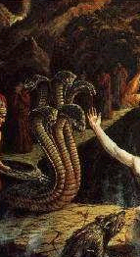
Clamness of mind or Sahej comes by continuous recitation on the Divine Name
“Dum Dum Sada Samalda Dum Na Birtha Jae” (556)
It is not proper to control one’s desires by force.
As a snake when shut up in a casket spites suddenly on the opening of the lid, similar are the desires of man.
One should recite the Name continuously to achieve calmness of mind.

Slide 9
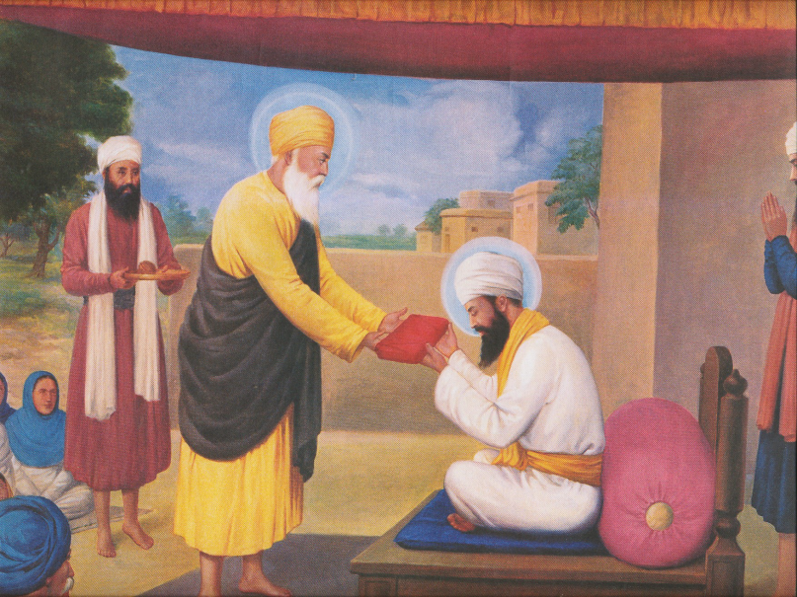
Obeying the wishes of God conscious person is the greatest meditation.
“Santo Sangar Paar Uttereeae. Je Ko Bachan Kammavee Santan Ka So GurparsaadiTareeiae.”
Bhai Lehna Ji served Guru Nanak Dev Ji with fulldevotion and dedication and earnestly obeyed hiscommands and was bestowed as second Guru of the Sikhs-Guru Angad Dev.

Slide 10
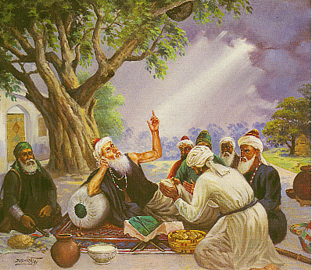
Always look at the virtues of others and introspect faults of your own.
“Fareeda Je Too Akal Latiff Kalae Likh Naa Lekh.
Aappnerae Giriwaan Meh Sir Neewan Kar Dekh.” (1378)

Slide 11
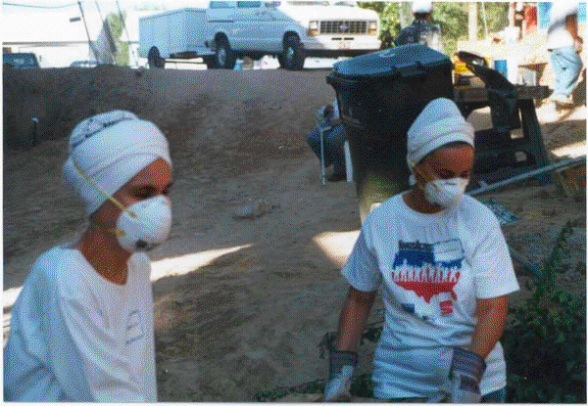
Selfless aervice helps in smoothening of mind, makes one humble and attaches oneself to ‘Shabad’.
“Tun Mun Dhan Sabh Saump Gur Kao Hukam Maneeyae Paayeea.” (918)
True SEVA from the heart….removes ego….

Slide 12
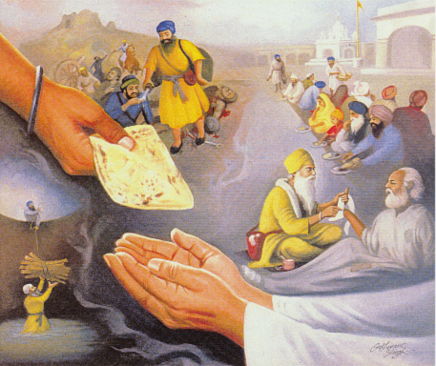
Three types of service :
1Earn by honest means and share the money with needy
“Ghal Khayae Kich Hathon Dae Nanak Rah Pacchanae Sae.”

Slide 13
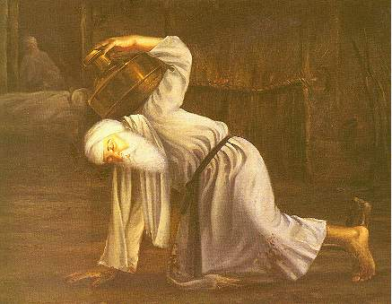
2 Putting oneself in service of others
. “Gur Sewa Te Sukh upjae Phir Dukh Na Lagae Aae.
Jaman Marna Mit Gayaa Kalae Ka Kich Na Basae”
“Jis Aaap Boojhae Aaap Su Har Marug Payeeae.
Gur Purae Vakhalyae Gur Sewa Payeeae.” (644)
Sri Guru Amar Das Ji served Guru Angad Dev Ji when he himself was 62 years old.

Slide 14
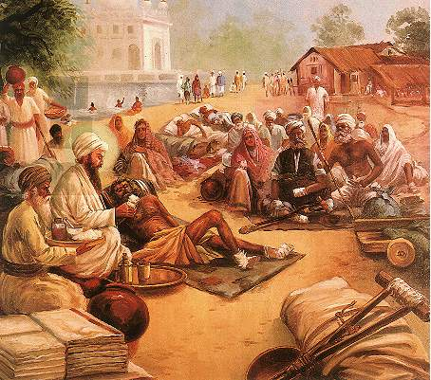
3 Service with devotion
One gets purification of mind with earlier two types of service.
One who always recities Shabad he attains the Almighty by rising step by step.
“Shabad Guru Suret Dhun Chela” (943)
“Eett Rah Patt Pawreea Chareeae Hoe Ekees.” (7)
GURU ARJAN DEV JI serving lepers at tarantaran

Slide 15
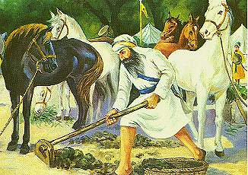
One must never run away from any strenuous selfless service and despite all odds he should go on.
“Hastee Sir Jion Ankas Hai Ahran Jion Sir Dae.
Mun Tun Aagaae Rakh Kae Oobhee Sew Karee.” (647)

Slide 16
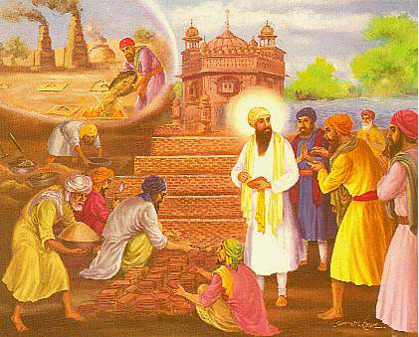
Don’t go in for a particular choosen service.
Do all the duties entrusted to you with full zeal and dedication without any consideration of success or failure.
One should understand that-
“Haun Moorakh Kaarae Layaa Nanak Har Kamae.”
And follow ‘Karam Yoga’ whileperforming His service.
“Karam Karat Hovae Nikharam. Tis Bassno Ka Nirmal Dharam.

Slide 17
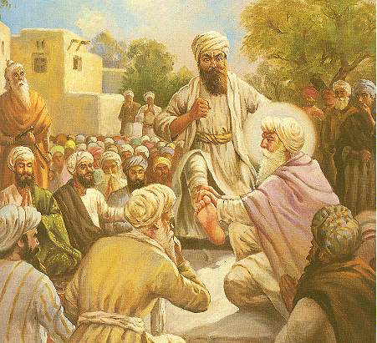
Always utter sweet words.
“Mithat Neeveen Nanaka Gun Changiaaian Tatt.” (470)

Slide 18
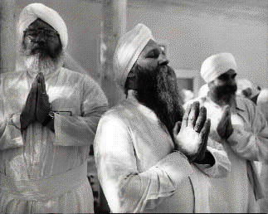
There is one abode of God who is an ever illuminating source of light.
A seeker who meditates with full dedication, devotion and humility and sits in the company of holy persons, attains this light.
“Jinee Naam Dhiayaae Gae Maskat Ghaal.
Nanak Te Mukh Ujjlae Keti Chuttee Naal.” (8)
REMEMBER WAHEGURU AT ALL TIMES..

Slide 19
Reciting the Divine Name is the true peaceful endeavour in Sikhism.
When Prithi Chand along with Sulhi Khan attacked Guru Arjan Dev Ji, he (the Guru) was reciting hymns at Sri Harmandar Sahib in Amritsar.
Many disciples asked the Guru to do something to face the attackers.
But Guru Ji asked them to remain intoned with the Lord by reciting hymns.
Meditation on ‘Shabad’ led to such a wave that Sulhi Khan died on his way when his horse slipped in a brick-Klin.

